Slide 1
The 6-point plan
YCNY

Slide 2
Your Care Needs You!
Patients to know more and do more (be more involved)
Health and wellbeing
Moving about (ADLs)
Medicines
What do to when at home
Booklet Film Advice sheet
Communication is key!

Slide 3
Get to know YCNY / getting it up & running
Working with your team
Team awareness & roles
Training
Other support
Monitoring

Slide 4
1. Get to know YCNY / getting it up & running
Undertake training provided by the PACT team
Work out
Which patients will get the booklet and film
When they will they get it
Will it be booklet, film, & advice sheet all together OR separate?
Which patients will get the advice sheet for managing at home
When they will get it
Who will give out the booklet, advice sheets, and show the film
How will you make these part of routine care
Discuss plans and make decisions with senior staff
Record your plans in your ACTION PLAN

Slide 5
2. Working with your team
Work with the team to decide what you can do to support YNCY by:
Enabling patients to do more things for themselves
Encouraging patients to ask staff questions
Supporting patients to get up and moving
Helping patients to practise taking their own medicines
See your Ward Facilitator pack for more suggestions
Record your plans in your ACTION PLAN

Slide 6
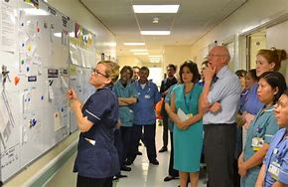
3. Team awareness & roles
Make sure everyone in the team knows about YCNY through:
Putting up posters (provided)
Sharing YCNY handouts (provided)
Providing access to the website (tablet provided on the ward)
In huddles, MDT meetings, handovers
Prompt cards (provided)

Slide 7
3. Team awareness
Help the team to engage in what YCNY is about
The website & your training can help with the short key messages such as:
Enabling patients to manage gaps in care
Thinking beyond getting people ‘fit for discharge’
Handovers of care to untrained patients vs fully trained health / social care professionals
Think about the benefits for staff (e.g. saving time)
Signpost staff to the website (e.g. animation film)

Slide 8
3. Team awareness & roles
Suggest roles for team members …
Clinicians – encourage asking questions about medicines
Nurses – ‘teach-back’ when dispensing meds
Physios – encourage get up & moving
Knows patient well – advocating
Blending into everyday tasks – prompting & reminding
Staff roles poster provided
(also see back of ward facilitator training pack for a copy)

Slide 9
4. Training
Training videos on the website on how to introduce the film and booklet
Prompt cards to guide introducing the film and booklet (provided)
Use of simple technique such as ‘Teachback’ (see your ward facilitator pack) with patients
Arrange for pharmacist / technician to advise on medication discussions or dispensing

Slide 10
5. Other support
Consultants on the ward
Ward manager
Physio lead
Discharge co-ordinator
Local lead for this study at your Trust*
Quality Improvement team
Ward facilitator from another YCNY ward*
People with influence, mentor, help problem solve
*Contact the PACT team if you are unsure

Slide 11
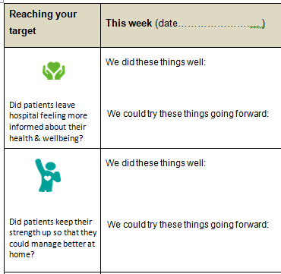
6. Monitoring
Check your Action Plan
Are things as you planned?
What went well?
What didn’t go well?
What could be done differently?
Record these in your monitoring form (provided)
Feedback to team regularly
Monitoring & feedback are effective tools for making and sustaining change

Slide 12
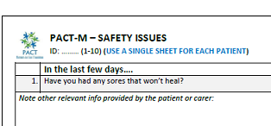
6. Monitoring
As part of monitoring you might want to see if you are improving patient experience
You can use a short measure (provided) to assess this. Instructions provided in the Ward Facilitator Pack
You can do this before you make any changes, during change and some time later. Feedback to your team

Slide 13
To sum up…
Training
Get to know YCNY and start planning
Working with your team
Team awareness
Training
Other support
Monitoring
Ward facilitator pack
Ward facilitator information pack
The website

Slide 14
Contact the PACT team for any queries
pact@bthft.nhs.uk

